Slide 1


GMR Institute of Technology, Rajam
Department of Information Technology
A Secure Communication Model Using AES Cryptographic Steganography
17-Oct-25
1
17-Oct-25
1

Slide 2
A Secure Communication Model Using AES Cryptographic Steganography
Student Name JNTU No.
V.Kula Sekhar 22341A12C9
A.Tarun Chandra 22341A12C3Model V.Uday Kiran 22341A12C8
Under the guidance of
Ch. Bharathi
Assistant Professor
GMR Institute of Technology

Slide 3
Abstract
In today's digital era, secure communication is vital to protect sensitive information from unauthorized access and cyber threats. This project presents a robust and integrated communication model that combines cryptographic encryption with media steganography to ensure both the confidentiality and invisibility of transmitted data. The system allows users to hide encrypted text within common media files such as images, audio, or video, making the hidden content indistinguishable from ordinary files. To enhance security, the system incorporates user authentication and controlled access mechanisms, ensuring that only authorized recipients can retrieve and decrypt the hidden data. By merging the strengths of cryptography and steganography, this model not only secures the message content but also conceals the existence of the communication itself. This framework is highly effective for secure data sharing across public or untrusted networks, making it suitable for applications in cybersecurity, confidential messaging, and secure data storage.
Keywords: Steganography, Multimedia Security, Information Hiding, Crptography.

Slide 4
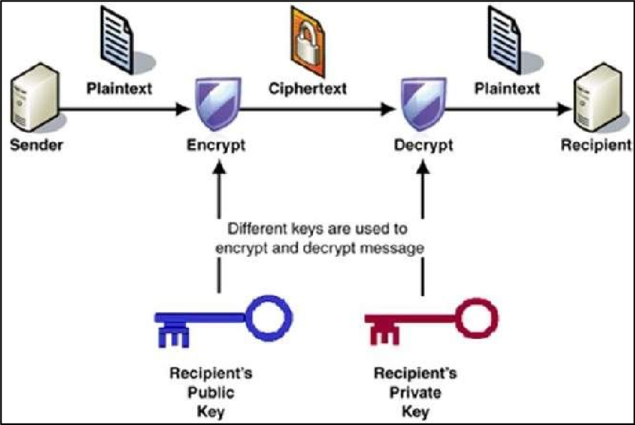
Introduction
In today’s digital world, the security of information has become a major concern due to the increasing risks of data theft and cyber-attacks. Cryptography ensures security by converting data into an unreadable format through encryption, while steganography hides the very existence of information by embedding it within media files such as images, audio, or video. When combined, these two techniques provide a dual layer of protection—cryptography safeguards the content of the message, and steganography conceals its presence—making communication more secure and reliable.

Slide 5
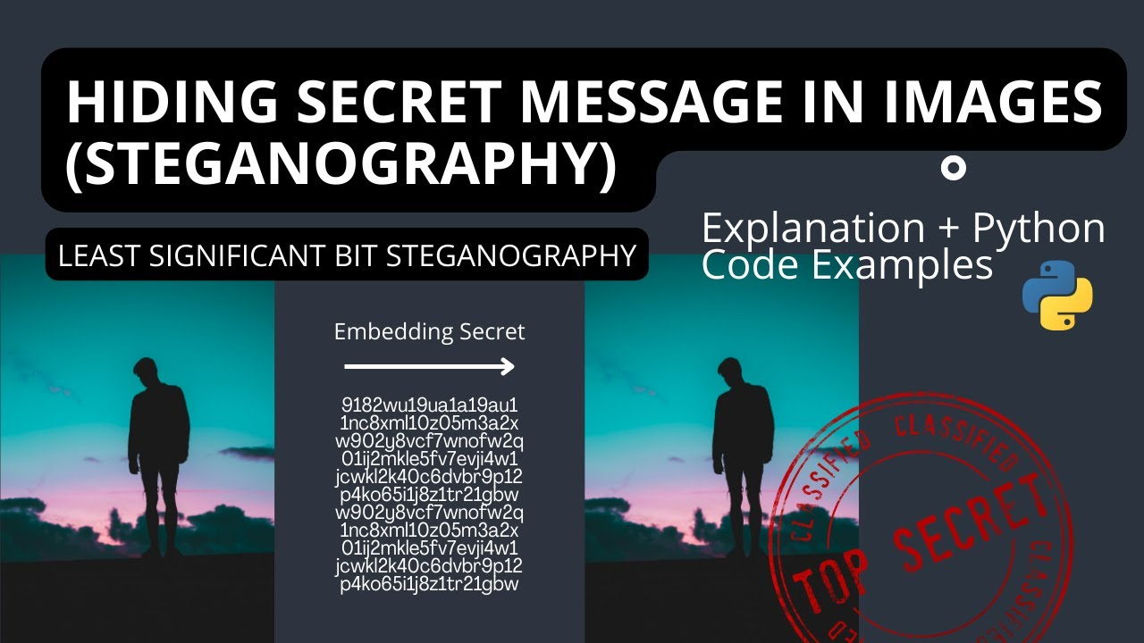

Slide 6
Literature survey
Reference 1 :Wahab, O. F. A., Khalaf, A. A., Hussein, A. I., & Hamed, H. F. (2021). Hiding data using efficient combination of RSA cryptography, and compression steganography techniques. IEEE access, 9, 31805-31815.
The literature review of the paper "Hiding Data Using Efficient Combination of RSA Cryptography, and Compression Steganography Techniques" discusses how combining cryptography and steganography creates a robust security solution. It emphasizes that data compression, particularly using algorithms like Huffman coding and Discrete Wavelet Transform (DWT), is essential for making data more secure and efficient to handle. The paper also reviews various steganography methods, such as Least Significant Bit (LSB) insertion, and concludes that an efficient combination of these techniques enhances both security and overall effectiveness.

Slide 7
Literature survey
Reference 2 :Feng, Y., Xu, L., Lu, X., Zhang, G., & Rao, W. (2025). A robust coverless audio steganography based on differential privacy clustering. IEEE Transactions on Multimedia.
The literature review of the paper "A Robust Coverless Audio Steganography Based on Differential Privacy Clustering" examines various methods in differential privacy clustering and coverless steganography. It highlights existing work on images and videos that use feature extraction and mapping rules to hide information without modifying the carrier, making them resistant to steganalysis. The paper then specifically addresses a GAN-based coverless audio steganography method, noting its limitation of requiring pre-shared network models. The review concludes that there is a significant lack of research on coverless audio steganography, a gap that the proposed method aims to fill.

Slide 8
Literature survey
Reference 3 : Zhang, L., Han, W., Chen, S., & Choo, K. K. R. (2023). An Efficient and Secure Health Data Propagation Scheme Using Steganography-Based Approach for Electronic Health Networks. IEEE/ACM Transactions on Networking, 32(2), 1261-1272.
The literature review for "An Efficient and Secure Health Data Propagation Scheme Using Steganography-Based Approach for Electronic Health Networks" discusses existing steganography methods used for protecting health data. It notes that while some schemes successfully embed and compress secrets, they often suffer from a lack of forward secrecy because encryption keys are not regularly updated and embedding locations are fixed. The paper also points out that many existing approaches sacrifice imperceptibility and embedding capacity for the sake of compression, which is a major gap in the current literature. The authors highlight the need for a solution that provides a better balance between security, capacity, and imperceptibility.

Slide 9
The literature review of the paper "An RGB Color Image Steganography Scheme by Binary Lower Triangular Matrix" reviews various image steganography methods, highlighting their limitations in terms of embedding capacity, visual quality, and security. It discusses LSB-based techniques, which are simple but can cause substantial distortion, especially with large payloads. The review also covers matrix embedding methods , which enhance payload capacity but often lack security. The paper notes that conventional methods are not well-suited for color images due to significant color distortions and a limited embedding capacity. The review also mentions methods using genetic algorithms, wavelets, and neural networks, ultimately concluding that a new approach is needed to provide a better trade-off between payload capacity, image quality, and security.
Literature survey
Reference 4 : Prasad, S., Pal, A. K., & Mukherjee, S. (2023). An RGB color image steganography scheme by binary lower triangular matrix. IEEE Transactions on Intelligent Transportation Systems, 24(7), 6865-6873.
Traditional steganography methods primarily use LSB substitution techniques (Chan and Cheng, T.-C Lu) and matrix embedding approaches (Fridrich and Soukal, Mao), while color image steganography has been explored through Hamming code methods (Banerjee and Jana) and smart pixel adjustment techniques (Yang and Wang). Advanced approaches incorporate genetic algorithms with wavelet transforms, adversarial embedding methods, and autoencoder-based techniques for robust data hiding. However, most existing methods face trade-offs between embedding capacity and visual quality, particularly for large payloads in RGB images, creating the need for novel matrix-based approaches.

Slide 10
Literature survey
Reference 5 : Xu, H., Cai, Z., Takabi, D., & Li, W. (2021). Audio-visual autoencoding for privacy-preserving video streaming. IEEE Internet of Things Journal, 9(3), 1749-1761.
The literature review for "Audio-Visual Autoencoding for Privacy-Preserving Video Streaming" highlights several limitations of existing privacy protection methods. Noise-based models often use noise with patterned distributions, which attackers can exploit as prior knowledge to infer private information. Furthermore, some of these models are trained to only fool specific types of discriminative models, making them ineffective against general detection models in real-world applications. The paper also points out that many existing models, including encryption-based ones, fail to address side-channel inference attacks. Finally, it notes that prior work typically focuses on visual privacy in separate video frames and neglects the temporal information (relationships between frames), which modern machine learning models can use to perform activities like action recognition.

Slide 11
Literature survey
Reference 6 : Kosuru, S. D., Pradhan, A., Basith, K. A., Sonar, R., & Swain, G. (2023). Digital image steganography with error correction on extracted data. IEEE Access, 11, 80945-80957.
Based on the paper "Digital Image Steganography With Error Correction on Extracted Data," the literature review highlights the limitations of traditional steganography techniques like Least Significant Bit (LSB) substitution, noting its vulnerability to detection and high distortion with larger payloads. It also discusses improvements like Pixel Value Differencing (PVD), which is less detectable but still vulnerable to analysis. The authors also review hybrid approaches and other techniques that incorporate concepts like Modified Hamming Code, emphasizing that these methods often lack a focus on detecting and correcting errors in the hidden data after transmission, a gap that the paper's proposed method aims to address.

Slide 12
Literature survey
Reference 7 : Kaur, M., Alzubi, A. A., Walia, T. S., Yadav, V., Kumar, N., Singh, D., & Lee, H. N. (2023). EGCrypto: A low-complexity elliptic galois cryptography model for secure data transmission in IoT. IEEE Access, 11, 90739-90748.
The literature review for "EGCrypto: A Low-Complexity Elliptic Galois Cryptography Model for Secure Data Transmission in IoT" discusses various security models for IoT networks, including elliptic Galois cryptography and matrix XOR steganography (EGMX), a probabilistic and lightweight approach (PLA), and optical ghost steganography (OGS). The paper also mentions other methods like homomorphic encryption (HomEnc) and a hybrid cloud solution (HCS). The review notes that despite these advancements, existing approaches still face challenges with scalability, computational complexity, and hyperparameter tuning. The paper concludes that there is a lack of standardized guidelines and automated tools for hyperparameter tuning in current solutions.

Slide 13
Literature survey
Reference 8 : Subramanian, N., Cheheb, I., Elharrouss, O., Al-Maadeed, S., & Bouridane, A. (2021). End-to-end image steganography using deep convolutional autoencoders. IEEE Access, 9, 135585-135593.
The paper "End-to-End Image Steganography Using Deep Convolutional Autoencoders" reviews the evolution of steganography from its historical roots to modern digital techniques. It highlights the limitations of traditional methods like Least Significant Bits (LSB) and Pixel Value Differencing (PVD), noting their restricted hiding capacity and vulnerability to attacks. The review then focuses on the recent shift towards deep learning, particularly the use of CNN-based architectures, GANs, and Autoencoders. The authors point out that these modern methods overcome the limitations of older techniques by offering improved security, robustness, and, most importantly, the ability to embed entire images, including three-channel RGB images. This capability is a significant advancement over previous methods.

Slide 14
Literature survey
Reference 9 : Mahmoud, M. M., & Elshoush, H. T. (2022). Enhancing LSB using binary message size encoding for high capacity, transparent and secure audio steganography–An innovative approach. IEEE Access, 10, 29954-29971.
The literature review for "Enhancing LSB Using Binary Message Size Encoding for High Capacity, Transparent and Secure Audio Steganography-An Innovative Approach" focuses on the weaknesses of traditional LSB, such as its deterministic nature and vulnerability to attacks like noise, re-sampling, and LSB attacks. It highlights various enhancements proposed by researchers, including embedding in higher-bit locations to improve robustness against noise , combining steganography with encryption to enhance security , and using chaotic maps to achieve non-deterministic embedding for greater security. The review concludes that most previous studies lacked adaptivity and randomness, which the proposed method aims to address.

Slide 15
Literature survey
Reference 10 : Hu, X., Li, S., Ying, Q., Peng, W., Zhang, X., & Qian, Z. (2024). Establishing robust generative image steganography via popular stable diffusion. IEEE Transactions on Information Forensics and Security.
The literature review for "Establishing Robust Generative Image Steganography via Popular Stable Diffusion" discusses the evolution of steganography, from traditional methods to modern generative approaches. It highlights the limitations of traditional, modification-based schemes like LSB, which are vulnerable to steganalysis due to detectable changes in histogram statistics. The paper also points out that existing generative steganography methods suffer from limited visual quality and are not robust enough for real-world scenarios with lossy transmissions and unknown channel attacks. The authors' proposed framework addresses these challenges by using the Stable Diffusion model to generate stego images without the need for additional training or fine-tuning, while also overcoming the numerical instability and perturbation sensitivity inherent in diffusion models. It also introduces a novel mapping module to enhance security and robustness.

Slide 16
Literature survey
Reference 11 : Almohammedi, A. A., & Shepelev, V. (2021). Saturation throughput analysis of steganography in the IEEE 802.11 p protocol in the presence of non-ideal transmission channel. IEEE Access, 9, 14459-14469.
This paper analyzes WiPad steganographic data hiding in IEEE 802.11p vehicular networks, which conceals secret messages in OFDM symbol padding at the physical layer. The authors develop a 2-D Markov chain mathematical model to evaluate system throughput under realistic non-saturated network conditions with transmission errors and various network parameters. MATLAB and SUMO/NS-2 simulations demonstrate that steganographic throughput decreases as vehicle numbers, traffic arrival rates, packet sizes, and bit error rates increase. The research shows that channel quality significantly impacts covert data transmission performance in practical vehicular communication environments.

Slide 17
Literature survey
Reference 12 : Khari, M., Garg, A. K., Gandomi, A. H., Gupta, R., Patan, R., & Balusamy, B. (2019). Securing data in Internet of Things (IoT) using cryptography and steganography techniques. IEEE Transactions on Systems, Man, and Cybernetics: Systems, 50(1), 73-80.
This paper proposes a dual-layer security approach for IoT data protection using Elliptic Galois Cryptography (EGC) combined with Matrix XOR steganography. The authors first encrypt sensitive medical data using elliptic curve cryptography over Galois fields with chaotic neural networks, then hide the encrypted data within H.264 video frames using an optimized steganography technique. An Adaptive Firefly optimization algorithm selects optimal image blocks for data embedding to minimize visual distortion while maximizing hiding capacity. Experimental results show the proposed method achieves 86% embedding efficiency and outperforms existing techniques (LSB, FMO, OMME) in metrics like PSNR, carrier capacity, and time complexity, providing enhanced security for medical IoT communications through this cryptography-steganography hybrid approach.

Slide 18
Literature survey
Reference 13 : Zhang, X., Chen, K., Ding, J., Yang, Y., Zhang, W., & Yu, N. (2024). Provably secure public-key steganography based on elliptic curve cryptography. IEEE Transactions on Information Forensics and Security, 19, 3148-3163.
The paper, "Provably Secure Public-Key Steganography Based on Elliptic Curve Cryptography," proposes a practical public-key steganography method. The authors leverage elliptic curve cryptography and a generative model to create a comprehensive and practical approach to public-key steganography and key exchange. The paper also provides a specific instance of the proposed method and proves its security based on computational complexity theory. Experiments have further demonstrated the method's security and efficiency

Slide 19
Literature survey
Reference 14 : Driss, M., Berriche, L., Atitallah, S. B., & Rekik, S. (2025). Steganography in IoT: A Comprehensive Survey on Approaches, Challenges, and Future Directions. IEEE Access.
The paper titled "Steganography in IoT: A Comprehensive Survey on Approaches, Challenges, and Future Directions" is a survey that provides an in-depth review of steganographic techniques for the Internet of Things (IoT). The paper addresses the security concerns that arise from the transfer of sensitive data among resource-constrained IoT devices. The authors explore various approaches, including spatial, frequency, and hybrid methods used in images, videos, audio, and text. They also evaluate these techniques based on key metrics like imperceptibility, robustness, and embedding capacity, while considering the computational, energy, and real-time processing requirements of IoT devices. The paper concludes by suggesting future research directions for developing innovative steganographic solutions for IoT applications.

Slide 20
Literature survey
Reference 15 : Li, Q., Ma, B., Fu, X., Wang, X., Wang, C., & Li, X. (2024). Robust image steganography via color conversion. IEEE Transactions on Circuits and Systems for Video Technology.
The paper "Robust Image Steganography via Color Conversion" proposes a new method for hiding information within images by using de-colorization and colorization models. The goal is to make steganographic activity difficult for attackers to detect.The method works by first embedding secret information into a color cover image. This "stego image" is then de-colorized into a grayscale image, which is then transmitted over public channels. The receiver uses a corresponding colorization network to reconstruct the original stego image and extract the hidden information. The paper also incorporates a simulated attack module to enhance the robustness of the steganography. The authors' experiments demonstrate the feasibility and scalability of this approach.

Slide 21
Literature survey
Reference 16 : Dhawan, S., Chakraborty, C., Frnda, J., Gupta, R., Rana, A. K., & Pani, S. K. (2021). SSII: secured and high-quality steganography using intelligent hybrid optimization algorithms for IoT. IEEE Access, 9, 87563-87578.
The paper "SSII: Secured and High-Quality Steganography Using Intelligent Hybrid Optimization Algorithms for IoT" presents a secured steganography technique for the Internet of Things (IoT). The method utilizes a combination of algorithms to enhance security, image quality, and payload capacity. The proposed approach involves encrypting a secret image using a Binary bit-plane decomposition technique. This is followed by an adaptive embedding process powered by the Salp Swarm Optimization Algorithm (SSOA) to efficiently embed the encrypted data into a cover image. Finally, a hybrid Fuzzy Neural Network (HFNN) with a backpropagation learning algorithm is used to improve the quality of the resulting stego-images. The paper claims this technique outperforms existing methods in terms of security, image quality, and payload capacity.

Slide 22
Literature survey
Reference 17 : Zhou, Q., Wei, P., Qian, Z., Zhang, X., & Li, S. (2025). Improved generative steganography based on diffusion model. IEEE Transactions on Circuits and Systems for Video Technology.
The paper "Improved Generative Steganography Based on Diffusion Model" proposes an improved method for generative steganography that addresses the limitations of previous models like Generative Adversarial Networks (GANs) and Flow-based models.The paper highlights that GANs struggle with message recovery due to their non-reversible nature, while Flow models often produce unrealistic images. To overcome these issues, the authors use a diffusion model, which is inherently reversible and capable of generating high-quality images. The paper's key contribution is a novel framework that ensures perfect reversibility for hidden message recovery, which was not a feature of previous diffusion-based steganography methods. The proposed method is shown to be more effective in recovering the hidden message exactly as it was embedded.

Slide 23
Literature survey
Reference 18 : Zhang, X., Chen, K., Zhao, N., Zhang, W., & Yu, N. (2025). Provably Secure Public-Key Steganography Based on Admissible Encoding. IEEE Transactions on Information Forensics and Security.
The paper, "Provably Secure Public-Key Steganography Based on Admissible Encoding," presents a new approach to public-key steganography using elliptic curve cryptography. It aims to overcome the limitations of a previous method that could only be applied to a specific set of curves and utilize about half of the available curve points.To address these issues, the authors propose a more general method based on admissible encoding, which uses a tensor square function on known well-distributed encodings. This technique ensures the method can be deployed on all types of curves and use all of the points on the curve. The paper also provides theoretical analysis and experimental results to prove the effectiveness and security of the new scheme.

Slide 24
Literature survey
Reference 19 : Sharma, D., Prabha, C., Hassan, M. M., Abdulla, S., Bairagi, A. K., Alshathri, S., & El-Shafai, W. (2024). Securing X-Ray Images Into Cover Images Using Hybrid EBS Steganography With Five-Layer Cryptography. IEEE Access.
The paper, "Securing X-Ray Images Into Cover Images Using Hybrid EBS Steganography With Five-Layer Cryptography," presents a hybrid method to enhance the security and privacy of electronic medical images (EMI). The method uses a dataset of 5,856 X-ray images of varying dimensions, which are hidden one at a time into a single cover image using Edge-based steganography (EBS). The hidden image is then encrypted with five layers of cryptography. The goal of the research is to reduce computational time, making the method suitable for real-time applications. The paper concludes that this hybrid method is effective, as demonstrated by good results in performance tests such as SSIM, PSNR, and MSE.

Slide 25
Literature survey
Reference 20 : Kumar, A., & Pooja, K. (2021). Steganography-A data hiding technique. International Journal of Computer Applications, 9(7), 19-23.
The paper "Steganography- A Data Hiding Technique" provides an overview of steganography, defining it as the art of hiding information to conceal its existence. The authors explain that it differs from cryptography, which only scrambles the message content. The paper focuses on using digital images as a carrier for secret messages and analyzes some of the tools available. It discusses the history of steganography, its various uses, and a related field called steganalysis, which aims to detect hidden messages. The paper concludes that steganography and steganalysis will continually evolve, and a key future application will be digital watermarking.

Slide 26
Comparison Table
S.No | Title | Year | Objective | Advantages | Limitations | Gaps
1. | Hiding Data Using Efficient Combination of RSA Cryptography, and Compression Steganography Techniques | 2021 | To create a robust, double-layered security system by combining cryptography, compression, and steganography | Compressed data is more secure and efficient to handle. The combination of techniques offers a double layer of security. | The literature review does not explicitly list limitations of specific methods in the same way as the example. | To develop a single system that effectively combines data compression and RSA cryptography with steganography for enhanced security.
2. | A Robust Coverless Audio Steganography Based on Differential Privacy Clustering | 2025 | To propose a novel coverless audio steganography method that hides information by generating carriers and establishing mapping rules, rather than embedding data directly. | Enhanced security by resisting detection by steganalysis tools. High robustness against common audio attacks, particularly time-stretching, with a robustness rate of up to 95%. | Requires pre-shared network models between sender and receiver, limiting its practical applicability. The adaptability to new audio content is limited and may require model retraining. | he paper identifies a significant gap in the literature regarding a lack of studies on coverless audio steganography that resist steganalysis.

Slide 27
3 | An Efficient and Secure Health Data Propagation Scheme Using Steganography-Based Approach for Electronic Health Networks | 2024 | To propose a new scheme that achieves efficient and secure data propagation by balancing imperceptibility, embedding capacity, and compression, while also providing forward secrecy. | The proposed scheme provides forward secrecy by updating keys and embedding locations in each process, and it achieves a good balance between imperceptibility, embedding capacity, and compression. | The paper does not explicitly state the limitations of its own proposed method in the literature review. | The authors identified a significant gap in the existing literature regarding a lack of balance between imperceptibility, embedding capacity, and compression, as well as the absence of forward secrecy in previous schemes.
4. | An RGB Color Image Steganography Scheme by Binary Lower Triangular Matrix (Proposed) | 2013 | To devise a binary lower triangular matrix-based method to hide data in color pixels to achieve a trade-off between payload capacity and image quality. | Preserves significant visual quality and emphasizes security by using an indirect data-hiding mechanism. Provides a higher degree of visual quality and a higher level of bits embedding capacity. | The literature review does not explicitly state any limitations of the proposed method itself. | The authors identified a gap in existing methods, noting a lack of a good trade-off between payload capacity, image quality, and security, especially for color images.

Slide 28
5. | Audio-Visual Autoencoding for Privacy-Preserving Video Streaming (Proposed) | 2022 | To propose a new framework to encode and decode video using its extracted audio to protect individuals' privacy. | The model uses non-patterned noise from audio for better security, takes advantage of multiple data sources, and addresses side-channel inference attacks. | The literature review does not explicitly state any limitations of the proposed method itself. | The paper identifies a lack of existing methods that address side-channel inference attacks, utilize temporal information, or use non-patterned noise to enhance privacy.
6 | Digital Image Steganography With Error Correction on Extracted Data (Proposed) | 2023 | To propose an image steganography technique with a focus on detecting and correcting errors in the hidden data during transmission. | The method addresses the issue of data corruption during transit, which is a major concern in traditional steganography. | The paper does not explicitly state the limitations of its own proposed method in the literature review. | The authors identified a significant gap in existing steganography techniques, noting that they do not focus on detecting and correcting errors that may occur in hidden data during transmission.
7 | EGCrypto (Proposed Model) | 2023 | To propose an efficient and secure model for IoT networks using low-complexity elliptic Galois cryptography and matrix XOR steganography.. | Outperforms competitive models in PSNR, SSIM, NRMSE, carrier capacity, and embedding efficiency. Uses an optimization algorithm to select cover blocks, which enhances security by making the existence of the hidden message unknown to intruders. | The literature review does not explicitly state any limitations of its own proposed method. | This is the proposed model, designed to address the challenges faced by competitive approaches, such as scalability, computational complexity, implementation, key management, trade-offs, evolving threats, and hyperparameter tuning.

Slide 29
8 | End-to-End Image Steganography Using Deep Convolutional Autoencoders (Proposed) | 2021 | To use a deep convolutional autoencoder to embed a secret image inside a cover image and extract it from the stego image | Higher hiding capacity, security, robustness, and imperceptibility than other deep learning methods. Simple and lightweight architecture. | The paper does not explicitly state limitations of its own proposed method | To create a lightweight, simple deep convolutional autoencoder that overcomes the limitations of traditional methods.
9 | Enhancing LSB Using Binary Message Size Encoding for High Capacity, Transparent and Secure Audio Steganography-An Innovative Approach | 2022 | To propose a new LSB-based audio steganography method that uses a Binary Message Size Encoding (BMSE) mechanism to achieve high capacity, security, and transparency. | The proposed method enhances LSB audio steganography by embedding a secret message and its size in random samples, making it more secure and transparent. It also uses Huffman coding and AES-128 for compression and encryption. |  | The authors identified a gap in previous studies, which they note lacked adaptivity and randomness, making them vulnerable to attacks like noise, re-sampling, and LSB attacks.

Slide 30
10 | Establishing Robust Generative Image Steganography via Popular Stable Diffusion (Proposed) | 2024 | To propose a new robust generative image steganography scheme using the Stable Diffusion model to generate stego images without additional training or fine-tuning. | The proposed framework overcomes numerical instability and is resistant to attacks and lossy transmissions. It also provides a superior trade-off between extraction accuracy, robustness, security, and image quality. | The literature review does not explicitly state any limitations of the proposed method itself. | The authors identified gaps in existing generative steganography methods, noting they suffer from limited visual quality and are not robust enough for real-world scenarios with lossy transmissions and unknown channel attacks.
11 | WiPad Steganography in IEEE 802.11p Vehicular Networks | 2021 | To analyze WiPad steganographic data hiding in IEEE 802.11p vehicular networks and develop a 2-D Markov chain model to evaluate system throughput. | Conceals secret messages in OFDM symbol padding at the physical layer, which can be used for covert communication. | Steganographic throughput decreases as vehicle numbers, traffic arrival rates, packet sizes, and bit error rates increase. The method is also impacted by channel quality.
12 | Securing Data in IoT Using Cryptography and Steganography Techniques (Proposed) | 2029 | To propose a dual-layer security approach for IoT data protection by combining Elliptic Galois Cryptography and Matrix XOR steganography | Achieves 86% embedding efficiency, minimizes visual distortion, and maximizes hiding capacity using an Adaptive Firefly optimization algorithm. | Requires large annotated datasets for improving model accuracy. | The need for a more robust and efficient dual-layer security approach for medical IoT communications

Slide 31
13 | provably Secure Public-Key Steganography Based on Elliptic Curve Cryptography | 2024 | To propose a practical and provably secure public-key steganography method using elliptic curve cryptography and a generative model for key exchange. | The method is practical, comprehensive, and its security and efficiency have been demonstrated through experiments. |  | The paper addresses the limitations of existing provably secure steganography methods, which are dependent on a pre-shared key and face challenges like key agreement and user expansion.
14 | Steganography in IoT: A Comprehensive Survey on Approaches, Challenges, and Future Directions | 2025 | To provide an in-depth review of steganographic techniques for the Internet of Things (IoT), addressing security concerns with data transfer among resource-constrained IoT devices. | The paper is a comprehensive survey that explores and evaluates various approaches based on key metrics like imperceptibility. | The paper notes that traditional encryption techniques, while effective, are often computationally expensive. | The paper suggests future research directions for developing innovative steganographic solutions for IoT applications.
15 | Robust Image Steganography via Color Conversion | 2024 | To propose a new method for hiding information within images by using de-colorization and colorization models to make steganographic activity difficult for attackers to detect. | The method is robust against attacks and lossy transmissions and the authors' experiments demonstrate its feasibility and scalability. |  | The paper addresses the vulnerability of traditional methods to detection and the need for more robust steganography.

Slide 32
16 | SSII: Secured and High-Quality Steganography Using Intelligent Hybrid Optimization Algorithms for IoT | 2021 | To present a secured steganography technique for the Internet of Things (IoT) that uses a combination of algorithms to enhance security, image quality, and payload capacity. | The proposed approach uses a Binary bit-plane decomposition technique, Salp Swarm Optimization Algorithm (SSOA) for adaptive embedding, and a Hybrid Fuzzy Neural Network (HFNN) to improve stego-image quality. It claims to outperform existing methods in security, image quality, and payload capacity |  | The paper addresses the need for a secured and high-quality steganography technique for IoT that is more efficient than existing methods.
17 | Improved Generative Steganography Based on Diffusion Model | 2025 | To propose an improved generative steganography method based on the diffusion model to overcome the limitations of existing methods. | The model fulfills network reversibility while generating high-quality images | The hidden message recovery is not perfectly reversible in existing models. Existing diffusion models are typically trained for one-directional tasks, causing problems with bi-directional steganography | Existing diffusion models have problems with bi-directional steganography tasks and their message recovery is not perfectly reversible.

Slide 33
18 | Provably Secure Public-Key Steganography Based on Admissible Encoding | 2025 | To propose a more general elliptic curve public key steganography method based on admissible encoding. | The proposed method can be deployed on all types of curves, can be used to create a pseudo-random public-key encryption function, and its security and efficiency have been demonstrated through theoretical analysis and experimental results. | The paper notes limitations of previous methods but does not explicitly state limitations of its own proposed method. | The paper addresses the strict requirements on curve parameters and limited usability of a previous public-key steganography method.
19 | Securing X-Ray Images Into Cover Images Using Hybrid EBS Steganography With Five-Layer Cryptography (Proposed) | 2021 | To secure X-ray images into cover images using a hybrid EBS steganography method with five-layer cryptography. | It uses a hybrid approach with five-layer cryptography for enhanced security, improves embedding capacity, security, and PSNR. | Requires more image | The paper addresses the need for a more secure and efficient method for hiding sensitive medical images, such as X-rays, in a way that is resistant to various attacks.
20 | Steganography- A Data Hiding Technique | 2021 | To provide a comprehensive overview of steganography, its history, different techniques, and future applications. | The paper is an overview that defines the differences between steganography and cryptography, and highlights the use of digital images as carriers for secret messages. | Requires specialized hyperspectral sensors, computational complexity in processing data | The paper concludes that steganography and steganalysis will continually evolve, and a key future application will be digital watermarking.

Slide 34
Existing System
Cryptography-Based Systems:
These systems encrypt messages using algorithms like AES or RSA, protecting the content. However, they don’t hide the presence of the communication, which can still attract attacks.
Steganography-Based Systems:
These hide secret messages in media files like images, audio, or video. While they conceal the message, most do not encrypt the content, making it readable if discovered.
Limitations of the Existing Systems:
No combination of encryption + steganography for double-layer security.
Hidden messages are vulnerable if no encryption is applied.
Encrypted files are still visible and can be flagged by attackers.
Lack of user authentication, OTP verification, or access expiration features.
Cannot prevent unauthorized sharing or repeated access to the hidden data.

Slide 35
Proposed System
The system combines cryptography and steganography to provide secure and hidden communication.
User Registration & Login Users sign up with credentials and log in to access the system securely.
Message Encryption The user’s message is encrypted using a standard cryptographic algorithm (e.g., AES)
Steganographic Embedding The encrypted message is hidden within a media file (image, audio, or video).
Secure File Sharing The Stegno file can be downloaded or sent, with optional expiry or limited access.
Message Extraction & Decryption Authorized users can upload the Stegno file and decrypt the hidden message.

Slide 36
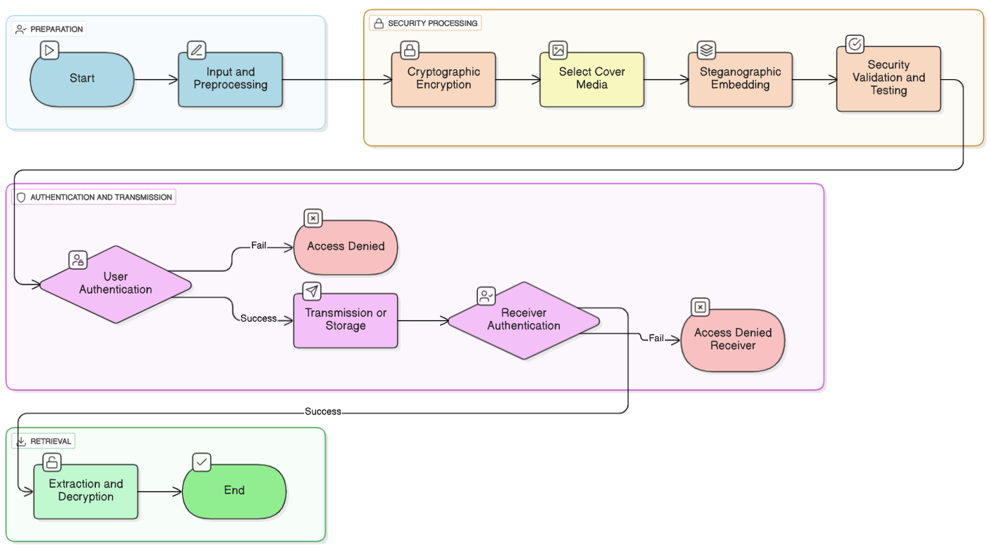
Proposed Workflow

Slide 37
1. Encryption (Secure Message)
This is the first critical step in the steganography process. Before the secret message is hidden, it’s encrypted using a strong algorithm like AES. This ensures that even if the hidden message is discovered, its contents remain completely unreadable without the correct decryption key. Encryption guarantees the data's confidentiality before it's embedded.
2. Payload Framing
After encryption, the secure message is prepared for embedding. This involves a process called payload framing, where essential metadata is added. This information can include the message's length, headers, or details about the encryption used. This framing ensures the recipient can correctly identify and process the hidden data once it's extracted from the carrier file.
3. Conversion to Bits
A fundamental step for all embedding techniques is converting the encrypted message into a binary bitstream. The entire payload, including its framing, is transformed into a long sequence of 1s and 0s. This conversion prepares the data in the precise format required to be directly written into the carrier file's pixels or frequency coefficients.

Slide 38
4. Embedding in Carrier
This is the core of steganography, where the bits of the secret message are hidden within a carrier file like an image, audio, or video. There are several ways to do this. Least Significant Bit (LSB) embedding modifies the last bits of pixel data, while palette-based embedding slightly alters color entries in indexed images. For a more robust approach, transform domain techniques embed data in the frequency coefficients of the carries, making it more resistant to compression.
5. Stego File Creation
Once the message bits have been embedded, the modified carrier file is saved as a new file, known as the stego file. This file looks identical to the original carrier, but it secretly contains the hidden data. From an outsider's perspective, the stego file appears completely normal, which helps to maintain the secrecy of the communication.
6. Extraction Process
On the receiving end, the hidden data must be retrieved from the stego file. This extraction process is the exact reverse of the embedding technique used. For an LSB-based stego file, the recipient reads the least significant bits to recover the data. For a transform domain file, an inverse transform is applied to retrieve the embedded coefficients, reconstructing the original bitstream.

Slide 39
7. Bitstream Reconstruction and Decryption
After extraction, the recovered bits are reconstructed back into the original encrypted payload. This final step prepares the data for decryption. Using the shared secret key, the recipient then decrypts the payload to reveal the original, plain-text message, completing the secure communication cycle.

Slide 41
References
[1]. Wahab, O. F. A., Khalaf, A. A., Hussein, A. I., & Hamed, H. F. (2021). Hiding data using efficient combination of RSA cryptography, and compression steganography techniques. IEEE access, 9, 31805-31815.
[2]. Feng, Y., Xu, L., Lu, X., Zhang, G., & Rao, W. (2025). A robust coverless audio steganography based on differential privacy clustering. IEEE Transactions on Multimedia.
[3]. Zhang, L., Han, W., Chen, S., & Choo, K. K. R. (2023). An Efficient and Secure Health Data Propagation Scheme Using Steganography-Based Approach for Electronic Health Networks. IEEE/ACM Transactions on Networking, 32(2), 1261-1272.
[4]. Prasad, S., Pal, A. K., & Mukherjee, S. (2023). An RGB color image steganography scheme by binary lower triangular matrix. IEEE Transactions on Intelligent Transportation Systems, 24(7), 6865-6873.
[5]. Xu, H., Cai, Z., Takabi, D., & Li, W. (2021). Audio-visual autoencoding for privacy-preserving video streaming. IEEE Internet of Things Journal, 9(3), 1749-1761.
[6]. Kosuru, S. D., Pradhan, A., Basith, K. A., Sonar, R., & Swain, G. (2023). Digital image steganography with error correction on extracted data. IEEE Access, 11, 80945-80957.

Slide 42
[7]. Kaur, M., Alzubi, A. A., Walia, T. S., Yadav, V., Kumar, N., Singh, D., & Lee, H. N. (2023). EGCrypto: A low-complexity elliptic galois cryptography model for secure data transmission in IoT. IEEE Access, 11, 90739-90748.
[8]. Subramanian, N., Cheheb, I., Elharrouss, O., Al-Maadeed, S., & Bouridane, A. (2021). End-to-end image steganography using deep convolutional autoencoders. IEEE Access, 9, 135585-135593.
[9]. Mahmoud, M. M., & Elshoush, H. T. (2022). Enhancing LSB using binary message size encoding for high capacity, transparent and secure audio steganography–An innovative approach. IEEE Access, 10, 29954-29971.
[10]. Hu, X., Li, S., Ying, Q., Peng, W., Zhang, X., & Qian, Z. (2024). Establishing robust generative image steganography via popular stable diffusion. IEEE Transactions on Information Forensics and Security.
[11]. Almohammedi, A. A., & Shepelev, V. (2021). Saturation throughput analysis of steganography in the IEEE 802.11 p protocol in the presence of non-ideal transmission channel. IEEE Access, 9, 14459-14469.
[12]. Khari, M., Garg, A. K., Gandomi, A. H., Gupta, R., Patan, R., & Balusamy, B. (2019). Securing data in Internet of Things (IoT) using cryptography and steganography techniques. IEEE Transactions on Systems, Man, and Cybernetics: Systems, 50(1), 73-80.
[13]. Zhang, X., Chen, K., Ding, J., Yang, Y., Zhang, W., & Yu, N. (2024). Provably secure public-key steganography based on elliptic curve cryptography. IEEE Transactions on Information Forensics and Security, 19, 3148-3163.

Slide 43
[14]. Driss, M., Berriche, L., Atitallah, S. B., & Rekik, S. (2025). Steganography in IoT: A Comprehensive Survey on Approaches, Challenges, and Future Directions. IEEE Access.
[15]. Li, Q., Ma, B., Fu, X., Wang, X., Wang, C., & Li, X. (2024). Robust image steganography via color conversion. IEEE Transactions on Circuits and Systems for Video Technology.
[16]. Dhawan, S., Chakraborty, C., Frnda, J., Gupta, R., Rana, A. K., & Pani, S. K. (2021). SSII: secured and high-quality steganography using intelligent hybrid optimization algorithms for IoT. IEEE Access, 9, 87563-87578.
[17]. Zhou, Q., Wei, P., Qian, Z., Zhang, X., & Li, S. (2025). Improved generative steganography based on diffusion model. IEEE Transactions on Circuits and Systems for Video Technology.
[18]. Zhang, X., Chen, K., Zhao, N., Zhang, W., & Yu, N. (2025). Provably Secure Public-Key Steganography Based on Admissible Encoding. IEEE Transactions on Information Forensics and Security.
[19]. Sharma, D., Prabha, C., Hassan, M. M., Abdulla, S., Bairagi, A. K., Alshathri, S., & El-Shafai, W. (2024). Securing X-Ray Images Into Cover Images Using Hybrid EBS Steganography With Five-Layer Cryptography. IEEE Access.

Slide 44


